Slide 1
Line Connector & Path Recommend
----Based On Spark GraphX
Team #2
Zechuan Miao
Lingyu Chen

Slide 2

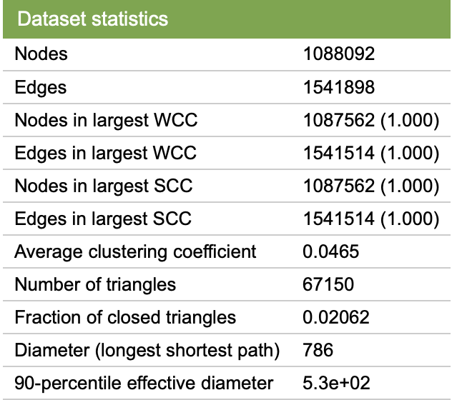
Use cases
The player provides the game screen shoots just like grid graph on the left. Our solver will print the solution, and draw it out.
We have huge grapghs like maps, Interpersonal relationships in real world world. Customer provides a start point and nodes they plan to visit. We will return him a one-way path solution that pass all nodes he wants without repetition.

Slide 3
Data Source
Screen Shoots from Line Connector game
Matrix scope: 4*5 ~ 5*6
Road network of Pennsylvania from Stanford Large Network Dataset Collection
Nodes: 1088092 Edges: 3083796

Slide 4
Milestones:
Mar, 30: implement utilizing Opencv package to convert screen shots of game to matrixes.
Apr, 8: implement API of undirected graph specified for this game, and implement the algorithms methods, return the solution.
Apr, 13: write tests and debug the game part of the project, also improve the algorithms to make it faster
Apr, 18: design the model to read in .gml file, and also convert real world maps to .gml files
Apr, 20: tests and calculate accuracy and speed of the project
Author: Zechuan
Author: Lingyu
Author: whole team
Use .txt file to replace .gml file
Author: whole team

Slide 5




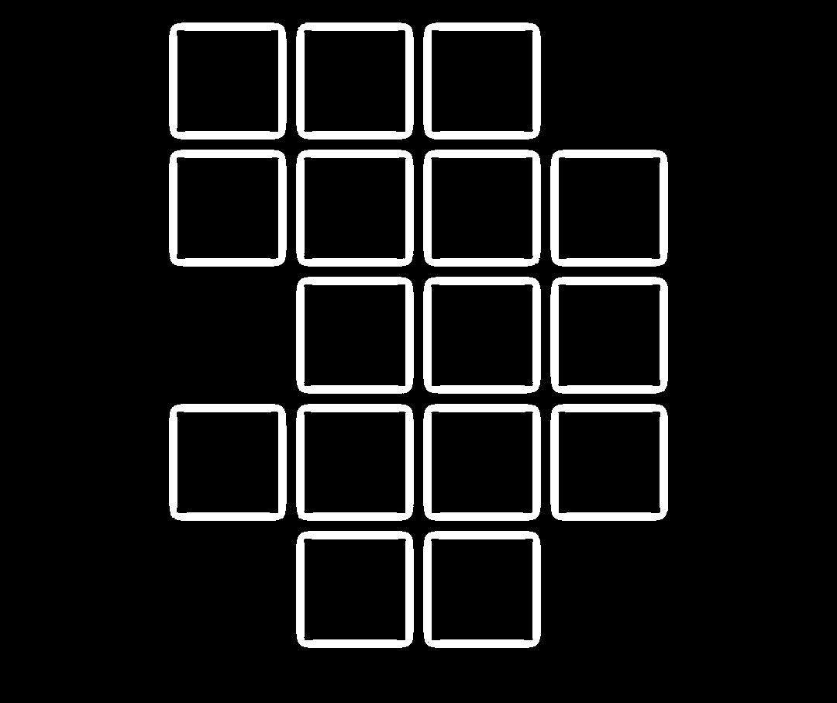



Image Converting: 1.binarization: binarize the origin image; 2.cut1: cut the noisy part; 3.cut2: cut the marginal 4.get all black line number => get the pixel coordinate and matrix row/col nummber;

Slide 6
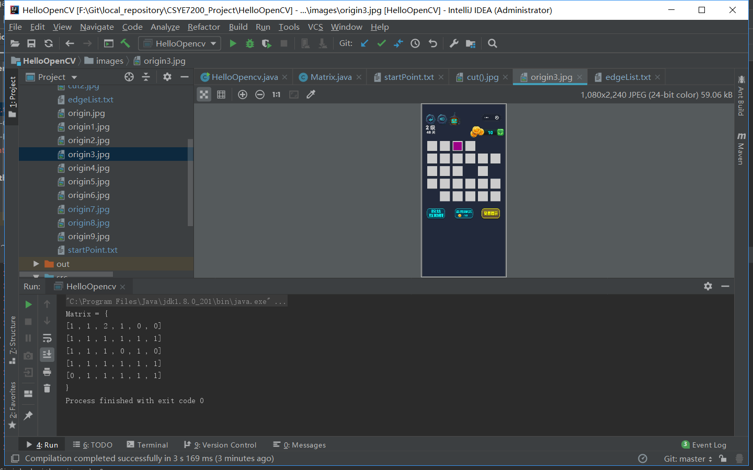
Image Converting

Slide 7
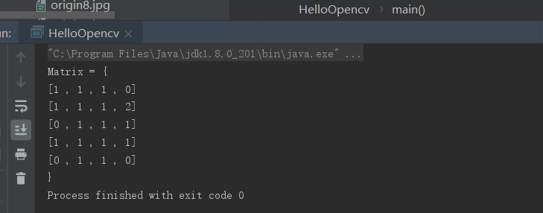
Then we have the matrix to solve this problem easily! our encapsulated class Matrix.toString() is like: 0 represents the unreachable node 1 represents the normal node 2 represents the start point

Slide 8
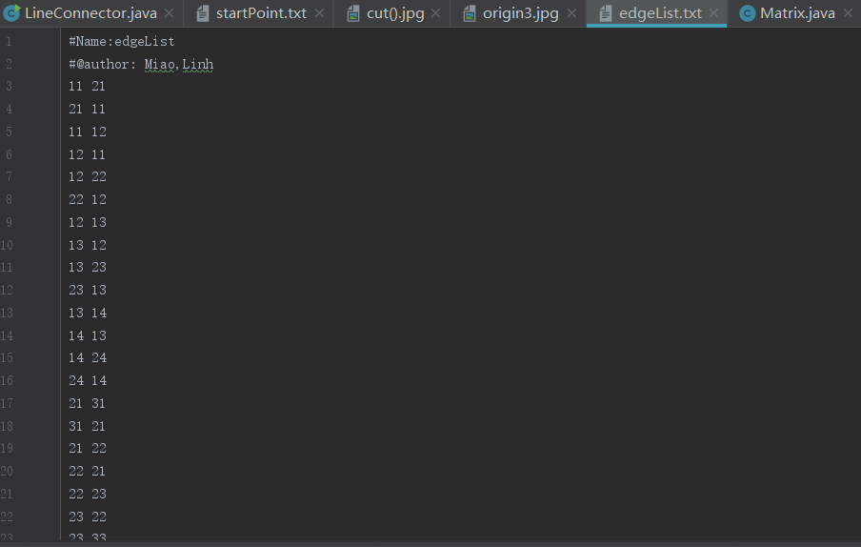
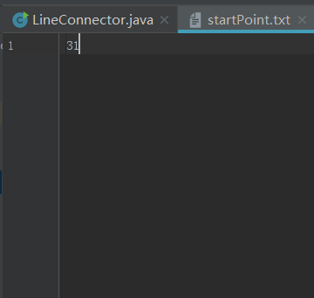
From the matrix we get(perfectly converted from smartphone screen shot of the game) Write it into the edgeList txt file, and the start Point txt file ReadGraph() => GraphX has strong API for graphloader and storage, use the dfs to solve it!

Slide 9
Road network of Pennsylvania
Nodes : the intersections
about 1 million
Roads: the edges
about 1.5 million (for undirected graph)

Slide 10
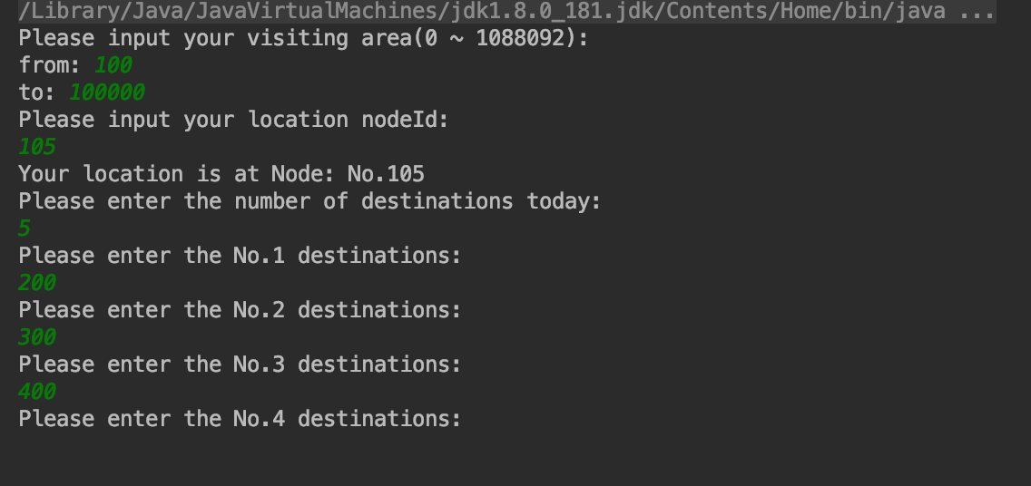
Single Interface for user to:
Input their:
1. Visiting area(a general scope)
2. Living node (where they start their journey)
3. Number of the spots they are going to visit
4. Every node they plan to visit

Slide 11
The program calculate the graph and return the shortest routine for user in their selected area:
Output:
one best(shortest) route goes from user living node through all selected destinations without duplication or backtrack.

Slide 12

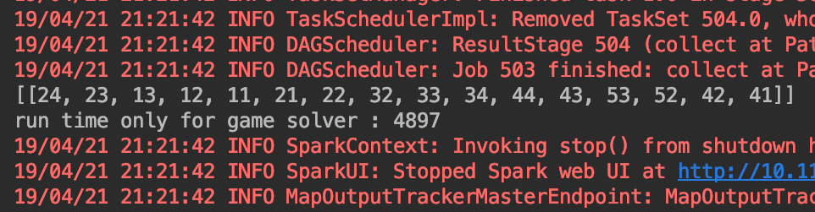
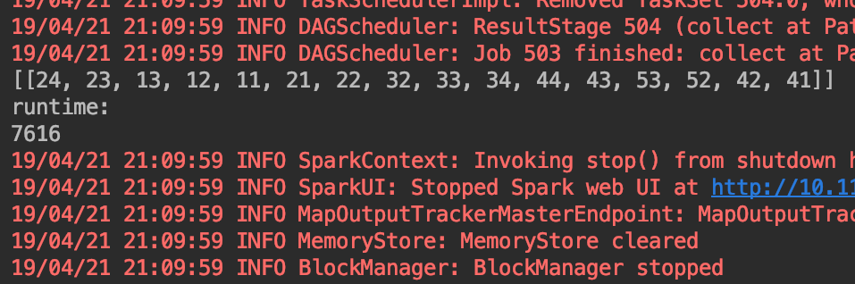
Criteria
For the game:
The success rate of converting screen shoot to matrix is 100%, takes less than 10 ms
The success rate of Line Connector is 100%
The success rate of the should be 100%, takes about 5 to 10 s

Slide 13

If the problem become more complicated, it can cost more time

Slide 14
Criteria
Test case:
Area: from 0 to 10000
Nodes: 8
Runt time for finding path from subgraph
Runt time for whole process, including extract subgraph

Slide 15
Criteria
For the real world road network:
Our System can provide the path for user in 2s for case that nodes less than 10
The success rate of the game part can be more than 90%, Why?

Slide 16
We use subgraphs
To improve the efficiency, we introduce the subgraph to reduce the dimension of problem. (Because we do not need to traverse all of the nodes apparently, it doesn’t make sense if the destination are thousands of edges apart)
Improvement: saves times strongly(30min traverse -> 2min return the same route)
Sacrifice: if the subgraph scope is less than 1000 or more ,we may lose some of the edges or connected nodes.

Slide 17
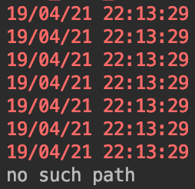
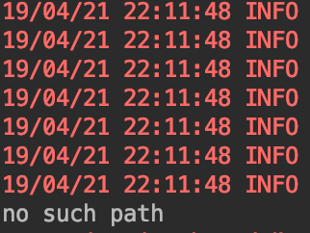
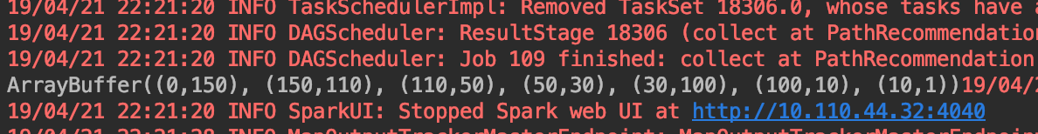
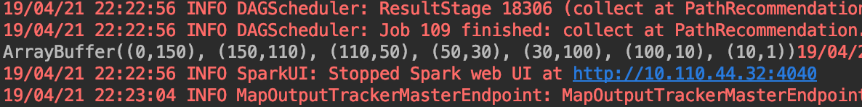
Subgraph of 1000 nodes level
Subgraph of 5000 nodes level
Test case:
Start point: 0
Pass ppints: 1, 10, 100, 30, 50, 110, 150
Subgraph of 8000 nodes level
Subgraph of 20000 nodes level
Subgraph of 50000 nodes level

Slide 18
Thank You

